Slide 1
Final Project
Student Designed Lab:
Physical Model for a Spring Pendulum
Karina Winn, Alex Blad, Kylee Thomas

Slide 2
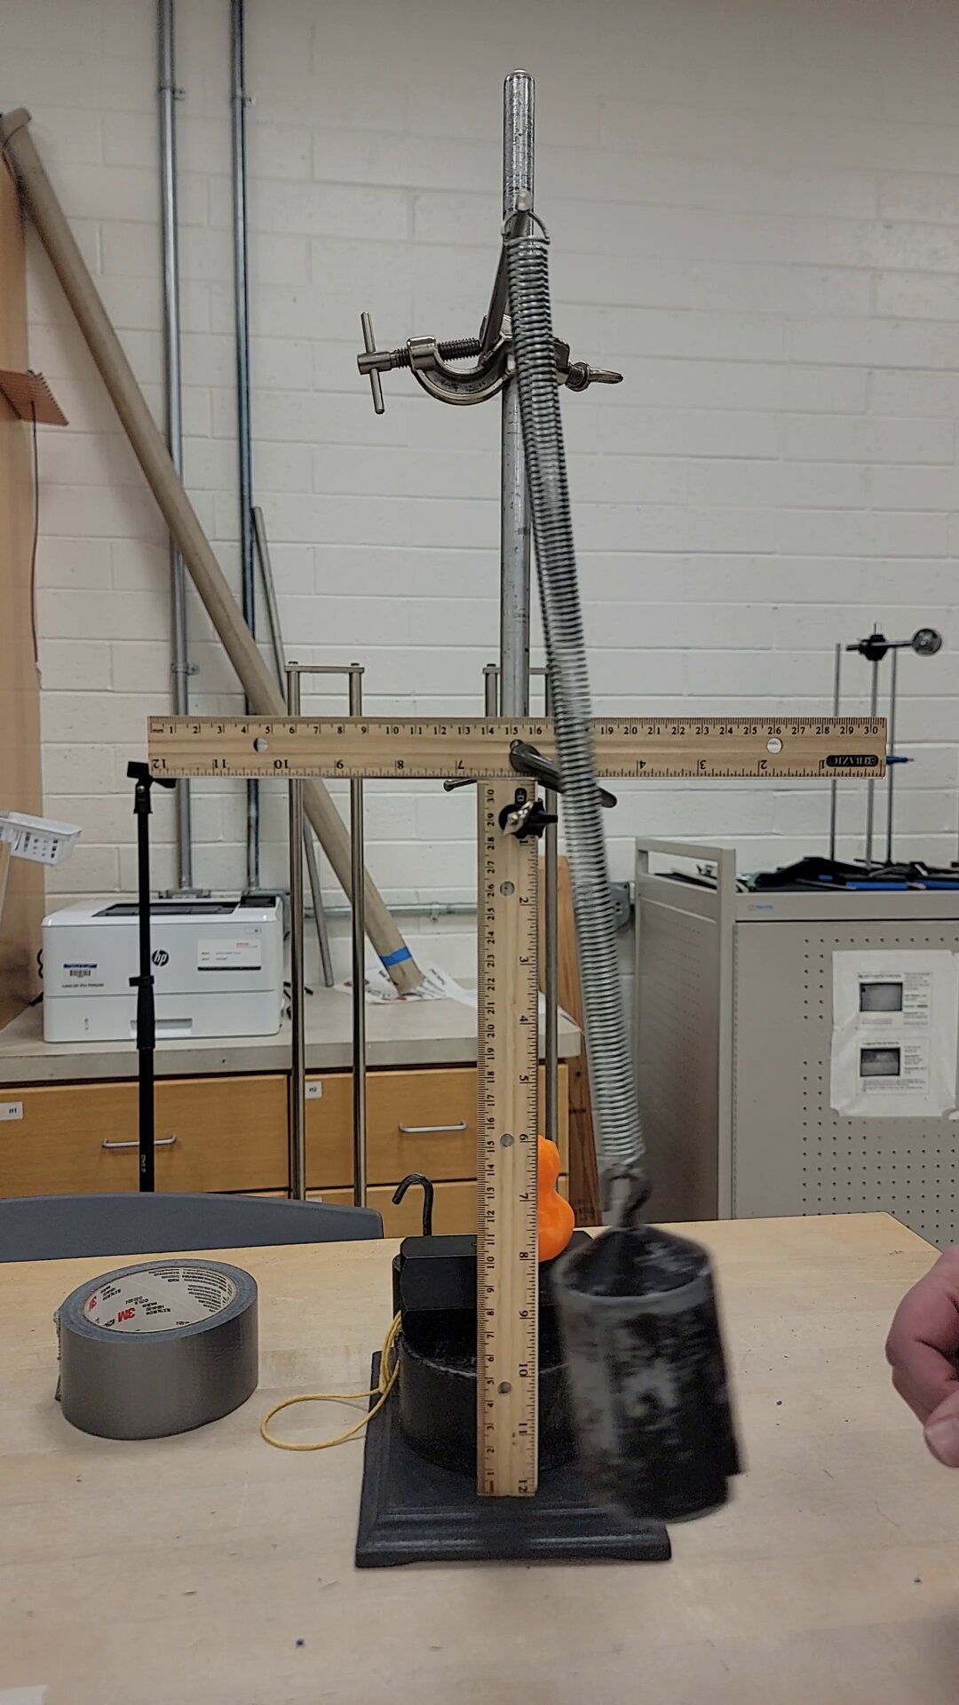
Method of Collecting Data
Made set-up with form of measurement (rulers connected)
Video recorded with 15 fps and collected points of location of mass for each frame
Measured approximate measurements (m,l,k,h) for starting variables of gradient code

Slide 3

Challenges
Measuring position of mass: (protractor didn’t work well)
Video analysis: how to log data
Code: many local minima, troublesome fit equations
Approximations made:
Small angle
Used only 2 dimensions, there may have been slight movement in the third dimension
Damping
Axis friction
Massless spring

Slide 4






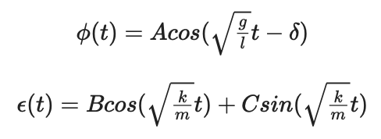
Finding an accurate fit model
Lagrange equations:
2 degrees of freedom - r (length of the spring) & Φ (angle of pendulum from vertical)
r = l (equilibrium length of spring) + 𝝐 (radial change from spring equilibrium)
After small angle approximations:

Slide 5
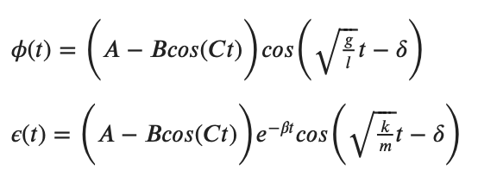
Method of minimizing Chi^2 / Optimizing fit variables
Gradient Search Method
New fit equations
Lots of local minima
Fitting parabola to the last three points

Slide 6
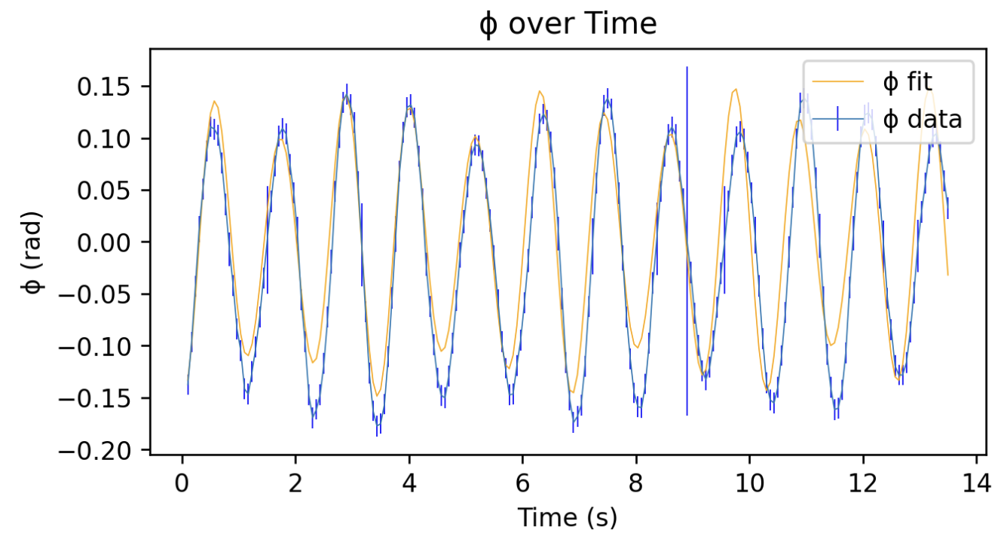
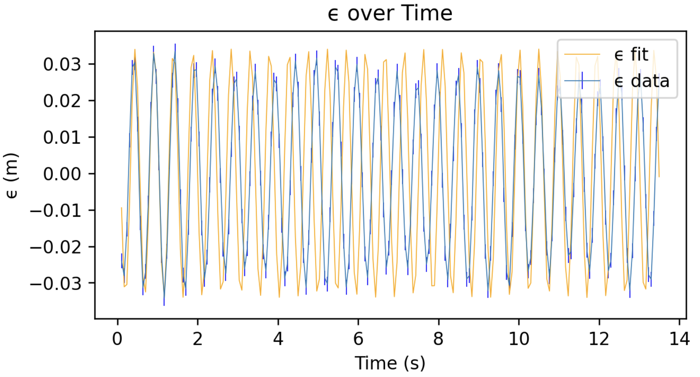
Results
Φ Equation: A = -0.125 ±1.586e-10, C = 1.900 ± 9.518e-09, l = 0.325 ± 6.345e-11, δ: 0.098 ± 3.173e-10
B: 0.260 ± 6.345e-10 (probably not valid)
Measured l = 0.261 ± 0.002 m
Chi Squared: 13.825, Correlation Coefficient: 0.923
𝝐 Equation: B = 0.001 ± 9.463e-12, C = 0.030 ± 4.731e-11, β = 4.380e-5 ± 2.366e-14
A = 0.040 ± 4.731e-11, δ = -0.400 ± 9.463e-10 (probably not valid)
Chi Squared: 51.386, Correlation Coefficient: 0.175

Slide 7
Future Experiments
Better measuring equipment
Optimization technique that handles local minima better
What happened with B parameter (phi equation), A and δ (epsilon equation)? Fix code accordingly
Physical meaning for other coefficients (whether they have to do with friction/damping, etc.)

